Slide 1



Adobe Analytics Challenge 2021
adobeanalyticschallenge.com
Team MOTIV8
#AdobeAnalyticsChallenge
1.Krishi Vijayanand (Team Leader)
2.Manjunathan.R
3.Nethra Prakash.K
4.Venkateswaran.N (Team Mentor)

Slide 2

Data : An overview into the Disney World
Disney website proves to be an impeccable e-commerce marketplace for Disney fans and similar animation franchise fans.
After careful analysis of the data, we have come up with a few recommendations to implement for better turnout, especially in Asia

Slide 3
AGENDA
1
IMPROVISE
2
ADAPT
3
OVERCOME

Slide 4

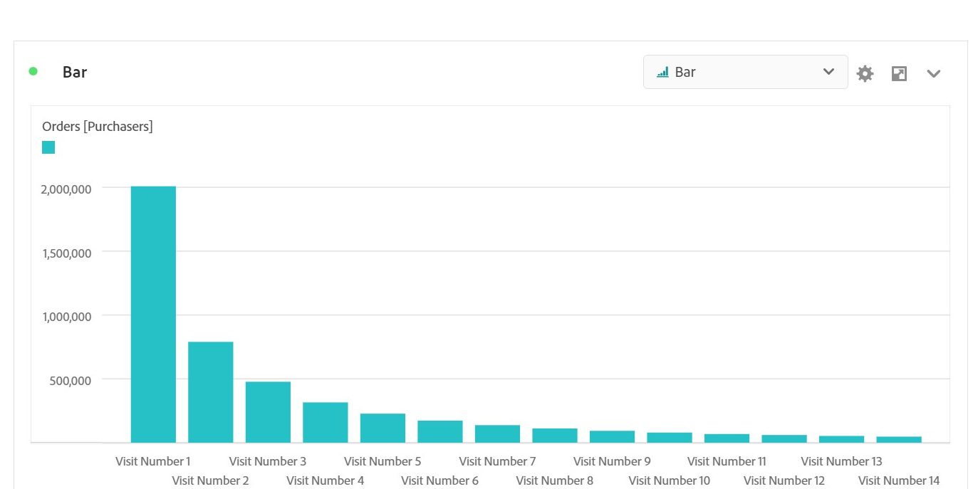
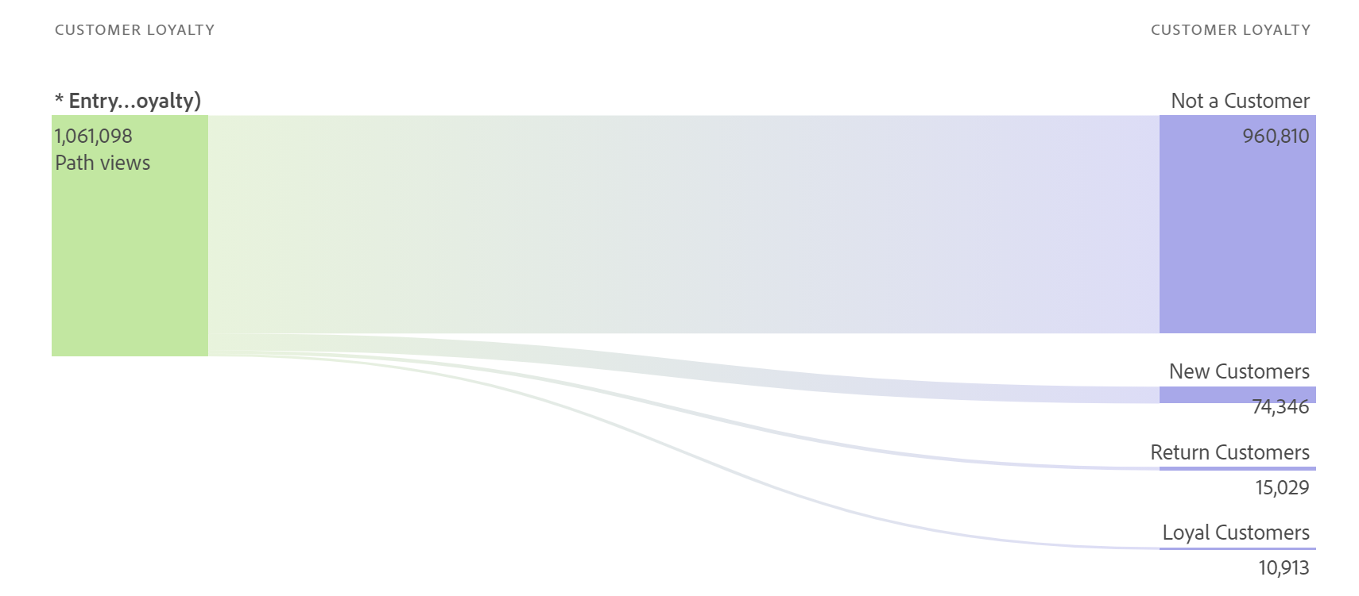
The maximum number of purchases are coming from First time visitors and then drops exponentially per visit.
The Loyalty per visit is also dismal with 1.028% loyalty rate

Slide 5


A simple purchase based loyalty program, potentially a Disney Reward Card, with redeemable points would do the trick
Promotion of the loyalty program must be tailored to fit each individual purchase/visit.
We predict an increase by a rough 60-70% margin in the number of Loyal customers by the closure of Business year of 2022, if such an incentive program is implemented.
Incentive if the purchase is done through the app will attract more customers to install the application.

Slide 6
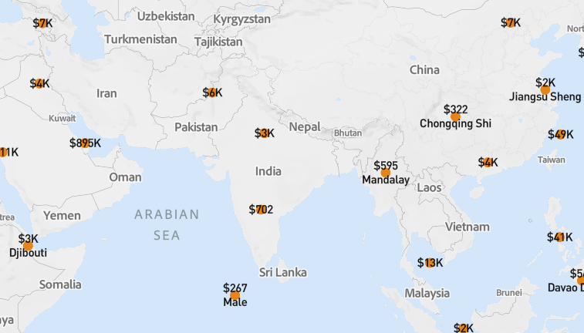
App and App Revenue
The Asian Market, contributes to dismal amounts of app revenue
Asia has a rapidly growing VFX and Animation market with growth at the rate of 23% YoY
However the market of the Disney in the US is about 1600 times bigger than the app market in India
It is also one of the biggest markets for merchandise consumption.

Slide 7
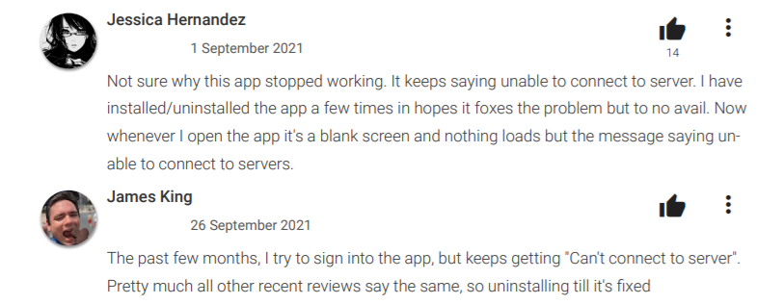
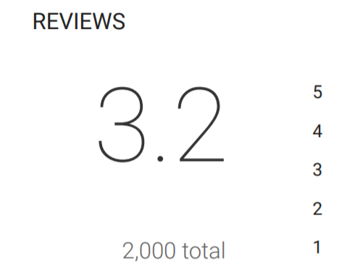
SENTIMENT ANALYSIS OF THE REVIEWS OF THE “SHOP DISNEY” APPLICATION
1
Multiple Citations of Server issues on Shop Disney app on Playstore
2
Dismal Review rating leads to poor sentiment among users, drastically affecting purchase%

Slide 8
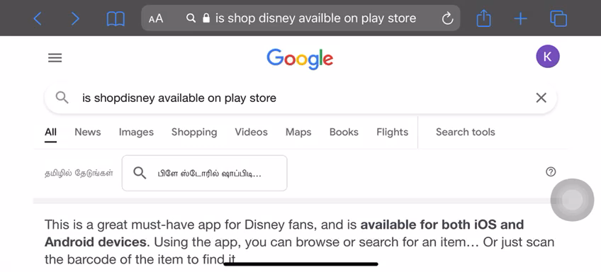
The shopDisney app on Play Store often faces server crashes.
This justifies the higher number of purchases from website and iOS devices.

Slide 9

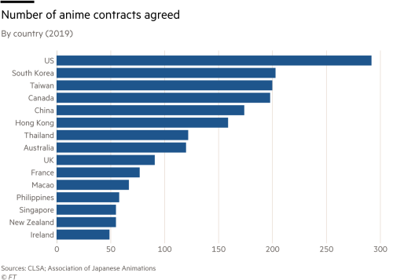
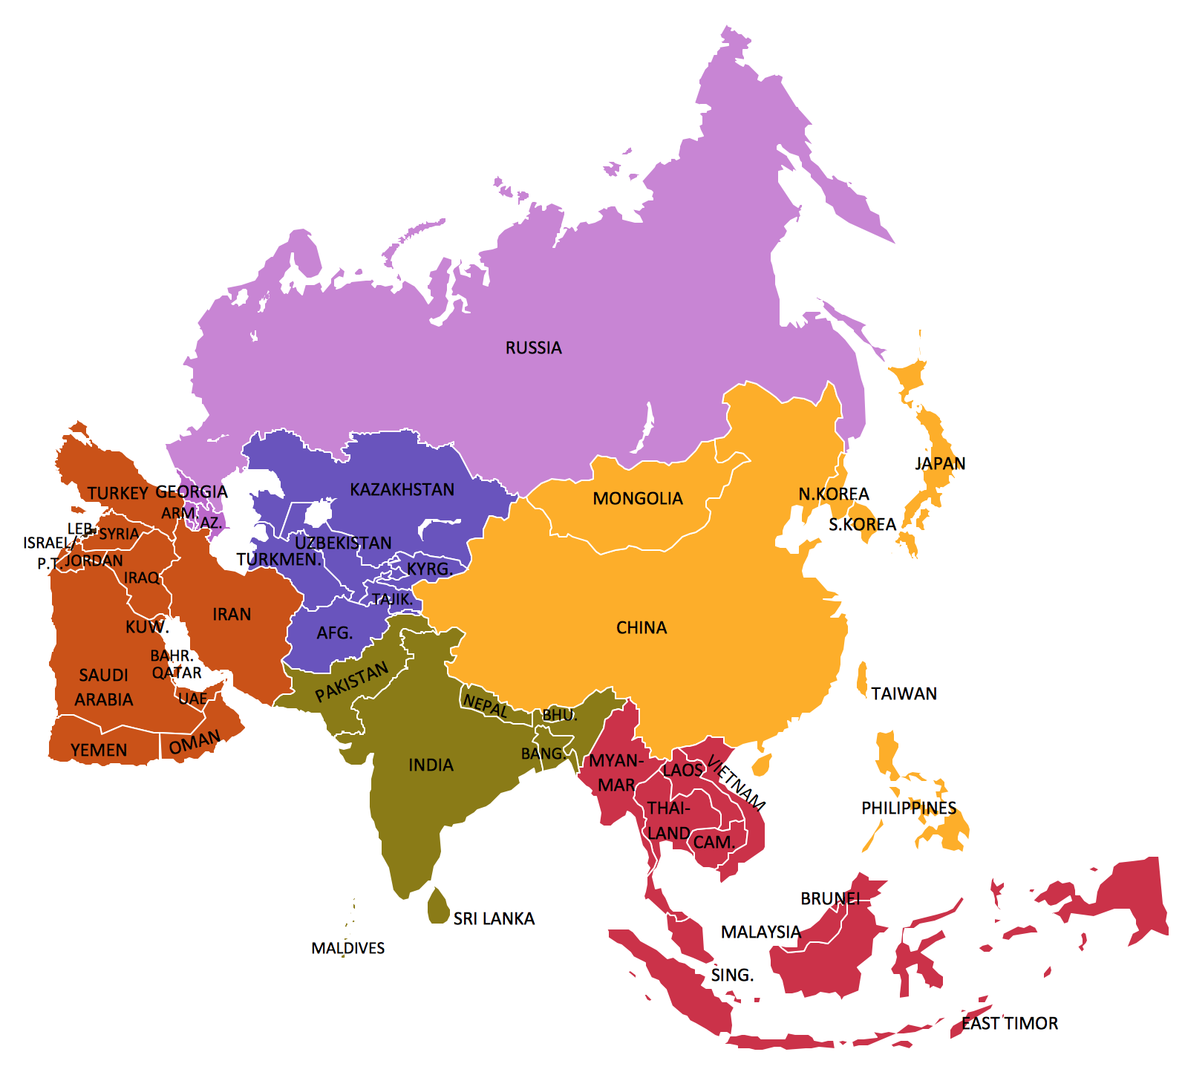
The Chinese and East Asian market is prime for Merchandise based contracts.
Hence Creating production units in the Asian markets will reduce the amount levied taxes and hence make the products cheaper for the Asian Consumers.

Slide 10

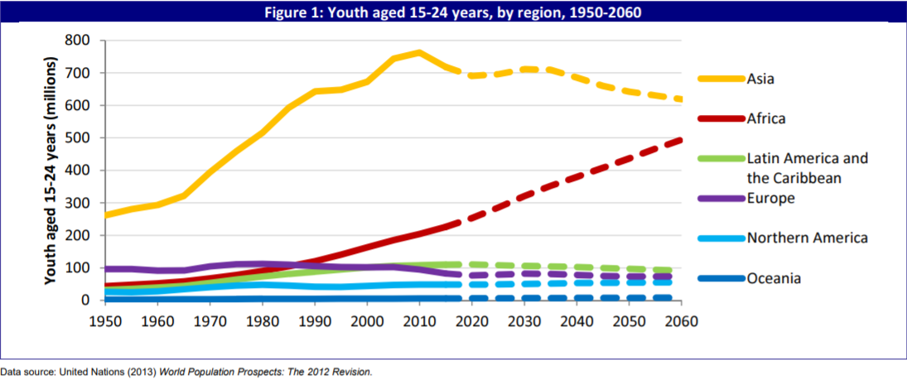
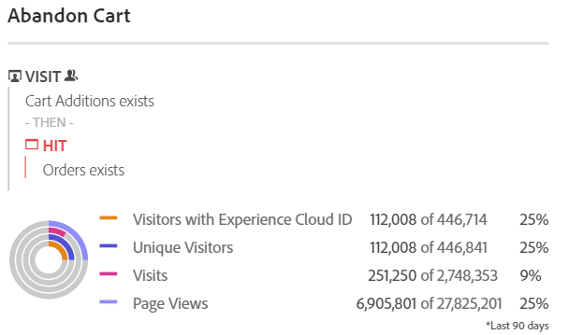
Revamping production in Asian starting from now will line up with the increase in population predicted in the upcoming years
Back to basics, Engagement and Constant Up-time boosts Purchases
Asian consumers are inclined towards buying products on SALE than on off day purchases.
A sales based engagement is developed to decrease the Cart Abandons by about 53% at the consumer level.

Slide 11
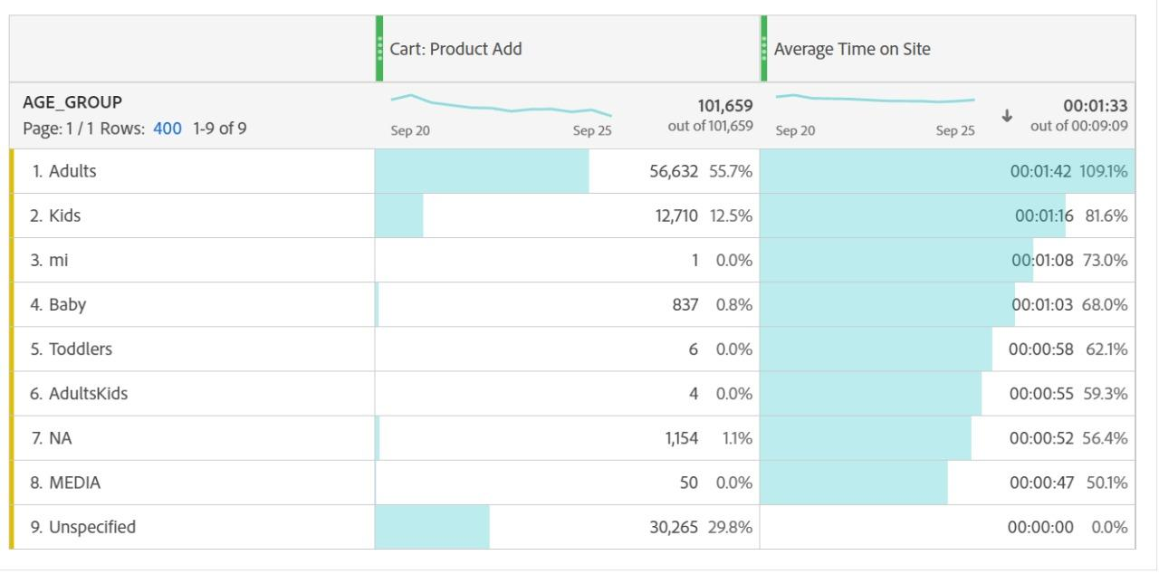
Where is the Attention coming from?
This indicates that Adults are taking over purchase commitments, however there is less engagement for Kids.
Emphasis on interactive games and activities can attract more screen time from the younger spectrum of the audience.

Slide 12
Server
The revamp of the shopDisney server for better reach.
Integrate functionalities from the website version.
Engagement
Better
Interactive In-Display games/Cartoons will improve on-screen time from kids, making it true to genre.
Connectivity
Better Production rates in Asian countries, revamping social marketing.
Incentives
Purchase based reward programs to hold back loyal customers.
“Disney is a fairytale come to reality”

Slide 13
adobeanalyticschallenge.com

